Slide 1
MIS 3301 Intro. to Business Programming Logic
Ch 3 – Decision Structures
Mrs. Nancy G. Sánchez

Slide 2
Outline
Types of IF Statements
Basic IF
IF-ELSE
IF-ELSE-IF
IF-ELIF-ELSE
Handling a Range of Values (series)
String Modification – lower(), upper(), title()
Working with Booleans
Create a Boolean Variables
Testing a Boolean Variable
Logical Operators – and, or, not
String Comparison

Slide 3
Basic IF

Slide 4
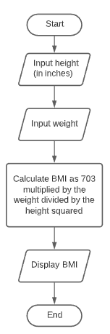
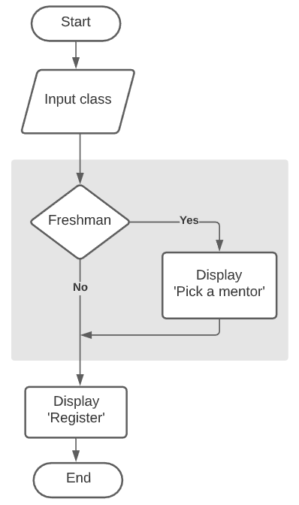
Control Structures
Ch2 Sequence
Control Structures – logical design that controls the order in which statements execute
Sequence Structure – Ch 2
Decision Structure – Ch 3: IF statements
Repetition Structure – Ch 4: Loops
Ch 3
Decision

Slide 5
Basic IF
Output Window
Enter class: Freshman
Pick a mentor
Register
classification = input('\nEnter class: ')
if classification == 'Freshman':
print('Pick a mentor')
print('Register')
Output Window
Enter class: Senior
Register
= → assignment
== → comparison

Slide 6
Basic IF
Boolean expression (conditional/logical test)
Boolean
True
False
IF clause
if classification == 'Freshman':
print('Get an advisor')
print('Pick a mentor')
colon
indenting
block
3 parts of a Boolean Expression
Value
Variable
String literal
Numeric literal
Calculation
Boolean
Constant
Relational
operators
>
<
>=
<=
==
!=
Value
Variable
String literal
Numeric literal
Calculation
Boolean
Constant

Slide 7
Exercise 1 – Basic IF
Write a program that allows a user to input hours worked. If the user worked more than 40 hours, display the phrase “Your pay will include Overtime!”.
Write the code.
Save your program as: Ch3-Ex01-IF.py
Run it!
Enter hours worked: 45
>> Your pay will include Overtime!

Slide 8
IF-ELSE

Slide 9
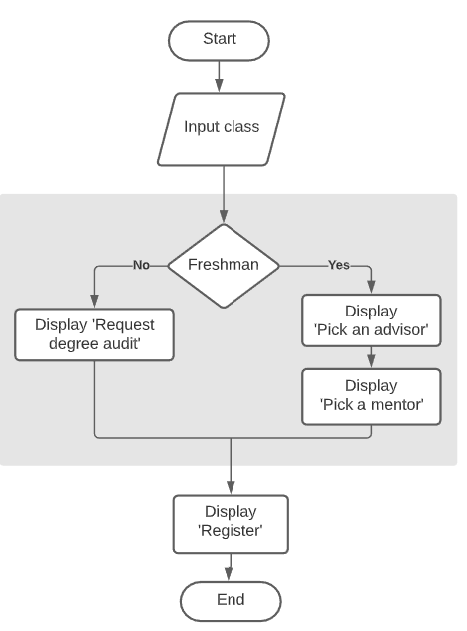
IF-ELSE
Output Window
if classification == 'Freshman':
print('Get an advisor')
print('Pick a mentor’)
else:
print('Request degree audit')
print('Register')
Enter class: Freshman
Get an advisor
Pick a mentor
Register
colon
then indent
Output Window
Enter class: Senior
Request degree audit
Register

Slide 10
Exercise 2 – IF-ELSE
Write a program that allows a user to input hours worked. Assume their hourly pay rate is $20.00. Calculate their total pay, keeping in mind that all hours over 40 are paid at twice their regular hourly rate and determine the appropriate message. Display the total pay & message.
Write comment lines for Constants, Input, Process, Output
Write the code.
Save your program as: Ch3-Ex02-IF-ELSE.py
Run it!
Enter hours worked: 45
Total pay: 1,000.00 >>> includes Overtime!
Enter hours worked: 33
Total pay: 660.00 >>> there is no Overtime pay!

Slide 11

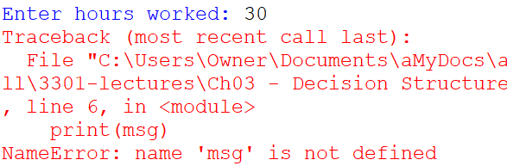
Beware of NameErrors!
In order to use a variable, it must have been assigned a value!
1.
2.
3.
4.
5.
6.
hours = float(input('\nEnter hours worked: '))
if hours > 40:
msg = 'Your pay will include Overtime!'
print(msg)
Must test your program with different test values!
Alternate Solutions:
hours = float(input('\nEnter hours worked: '))
if hours > 40:
msg = 'Your pay will include Overtime!'
else
msg = 'Your pay will not include Overtime!'
print(msg)
hours = float(input('\nEnter hours worked: '))
if hours > 40:
msg = 'Your pay will include Overtime!’
print(msg)

Slide 12
IF-ELSE-IF

Slide 13
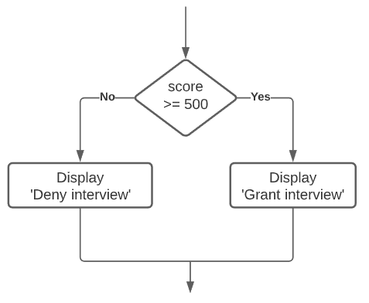
Review of IF-ELSE
Assume a business is interviewing candidates for a Programmer Analyst III position. Any candidate that scores at least 500 on their programming logic test will be offered an interview; others will be denied an interview.
Test score
deny
500
grant
if test_score >= 500:
print('Grant interview')
else:
print('Deny interview')

Slide 14
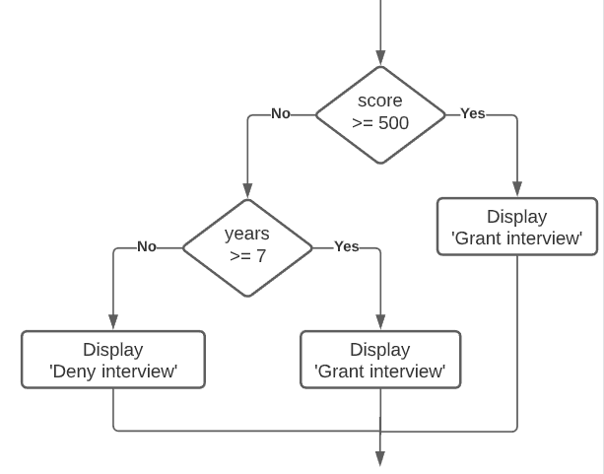
IF-ELSE-IF
Assume a business is interviewing candidates for a Programmer Analyst III position. Any candidate that scores at least 500 on their programming logic test will be offered an interview but, if their score is lower, it will depend on their years of programming experience – they must have at least 7 years of experience in coding.
Test score
500
grant
if test_score >= 500:
print('Grant interview')
else:
if years_exp >= 7:
print('Grant interview')
else:
print('Deny interview')
Years of
experience
deny
grant
7

Slide 15
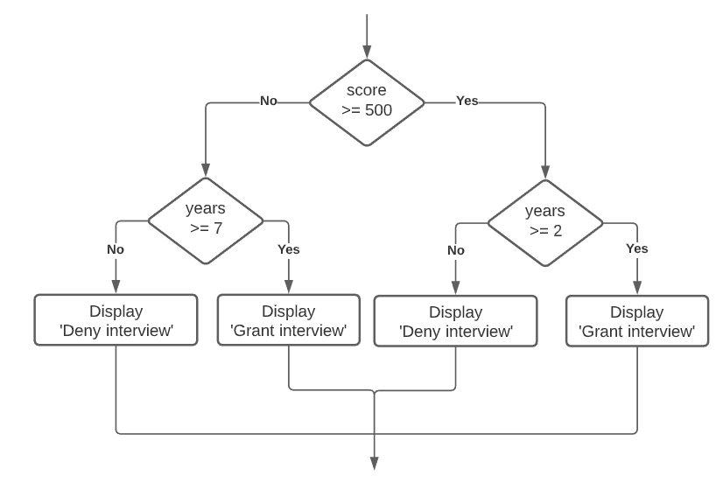
IF-ELSE-IF
Assume a business is interviewing candidates for a Programmer Analyst III position. Any candidate that scores at least 500 on their programming logic test and has at least 2 years of programming experience will be offered an interview. If their test score is lower than 500, it will depend on their years of programming experience – they must have at least 7 years of experience in coding.
Test
score
500
if test_score >= 500:
if years_exp >= 2:
print('Grant interview')
else:
print('Deny interview')
else:
if years_exp >= 7:
print('Grant interview')
else:
print('Deny interview')
Years of
experience
deny
grant
deny
grant
7
2

Slide 16
Range of Values (Series)
Body Temp
Body Temp
OK
Fever
Low
Normal
Fever
98.6
97
99
2 Categories
3 Categories
if temp >= 98.6:
print('Fever')
else:
print('OK')
How many IFs
do we need?
if temp >= 99:
print('Fever')
else:
if temp >= 97:
print('Normal temp')
else:
print('Low Temp')

Slide 17
Range of Values (Series)
Body Temp
Low
temp
Normal
temp
Low Fever
High
Fever
Fever
97
99
100.4
103.1
IF-ELSE-IF
IF-ELSE-IF with ANDs
if temp >= 103.1:
category = 'High Fever'
else:
if temp >= 100.4:
category = 'Fever'
else:
if temp >= 99:
category = 'Low Fever'
else:
if temp >= 97:
category = 'Normal temp'
else:
category = 'Low Temp'
if temp >= 103.1:
category = 'High Fever'
else:
if temp >= 100.4 and temp < 103.1:
category = 'Fever'
else:
if temp >= 99 and temp < 100.4:
category = 'Low Fever'
else:
if temp >= 97 and temp < 99:
category = 'Normal temp'
else:
category = 'Low Temp'
2 Issues:
Complexity
Maintenance

Slide 18
Range of Values (Series)
Body Temp
Low
temp
Normal
temp
Low Fever
High
Fever
Fever
97
99
100.4
103.1
IF-ELSE-IF → right to left
IF-ELSE-IF → left to right
if temp >= 103.1:
category = 'High Fever'
else:
if temp >= 100.4:
category = 'Fever'
else:
if temp >= 99:
category = 'Low Fever'
else:
if temp >= 97:
category = 'Normal temp'
else:
category = 'Low Temp'
if temp < 97:
category = 'Low Temp'
else:
if temp < 99:
category = 'Normal temp'
else:
if temp < 100.4:
category = 'Low Fever'
else:
if temp < 103.1:
category = 'Fever'
else:
category = 'High Fever'

Slide 19
Why is this so complex?
Body Temp
Low
temp
Normal
temp
Low Fever
High
Fever
Fever
97
99
100.4
103.1
IF-ELSE-IF → right to left
Why not write independent IFs?
if temp >= 103.1:
category = 'High Fever'
else:
if temp >= 100.4:
category = 'Fever'
else:
if temp >= 99:
category = 'Low Fever'
else:
if temp >= 97:
category = 'Normal temp'
else:
category = 'Low Temp'
if temp >= 103.1:
category = 'High Fever’
if temp >= 100.4:
category = 'Fever’
if temp >= 99:
category = 'Low Fever’
if temp >= 97:
category = 'Normal temp'
else:
category = 'Low Temp'

Slide 20
Exercise 3 – IF-ELSE-IF
Write a program that allows a user to enter Passing Yards and display the related performance rating (per the table). Notice these values represent a series/range of values. Use the IF-ELSE-IF structure.
Write comment lines for Input, Process, Output
Write the code.
Save your program as: Ch3-Ex03-IF-ELSE-IF.py
Run it!
Passing Yards | Perf. Rating
300+ | Elite
250-299 | Good
100-249 | Need Improvement
0-99 | Unacceptable

Slide 21
IF-ELIF-ELSE

Slide 22
Range of Values (Series) – using ELIF
Low
temp
Normal
temp
Low Fever
High
Fever
Body
Temp
Fever
97
99
100.4
103.1
Preferred!
IF-ELSE-IF
IF-ELIF-ELSE
if temp >= 103.1:
category = 'High Fever'
else:
if temp >= 100.4:
category = 'Fever'
else:
if temp >= 99:
category = 'Low Fever'
else:
if temp >= 97:
category = 'Normal temp'
else:
category = 'Low Temp'
if temp >= 103.1:
category = 'High Fever'
elif temp >= 100.4:
category = 'Fever'
elif temp >= 99:
category = 'Low Fever'
elif temp >= 97:
category = 'Normal temp'
else:
category = 'Low Temp'

Slide 23
Don’t forget about Constants!
See your
doctor
All is
well
Get
rest
Take
Tylenol
Go to
the ER!
#Constants
HIGH_FEVER_MIN = 103.1
FEVER_MIN = 100.4
LOW_FEVER_MIN = 99
NORMAL_MIN = 97
if temp >= HIGH_FEVER_MIN:
msg = 'Go to the ER!'
elif temp >= FEVER_MIN:
msg = 'Take Tylenol'
elif temp >= LOW_FEVER_MIN:
msg = 'Get rest'
elif temp >= NORMAL_MIN:
msg = 'All is well'
else:
msg = ' See your doctor'
Body
Temp
97
99
100.4
103.1
You can use constants in many places:
Calculations
IF statements
etc.

Slide 24
Exercise 4 – IF-ELIF-ELSE
Write a program that allows a user to input a Letter Grade and display the related description (per the table). You must use the IF-ELIF-ELSE structure.
Grade | Description
A | Excellent
B | Good
C | Average
D | Poor
F | Failing
Version 1
Write comment lines for Input, Process, Output
Write the code.
Save your program as: Ch3-Ex04-IF-ELIF-ELSE.py
Run it!
Test cases: test it with the following user entries:
A
C
F
X - notice the issue!
Version 2 - Let’s fix this issue:
Rename the Process section as “Process (ver 1)”.
Copy “Process (ver 1)” and paste it and re-name the new version as “Process (ver 2)”
Comment out “Process (ver 1)” → use Alt+3
In “Process (ver 2)”, modify the IF so that any value other than (A,B,C,D,F) are invalid.
Test “Process (ver 2)”with the same test cases.

Slide 25
@HOME → Exercise 5 – IF-ELIF-ELSE
Copy & paste the file from Exercise 3 and rename the new copy as: Ch3-Ex05-Another-ELIF-ELSE.py
Change the code from IF-ELSE-IF to use the IF-ELIF structure
Recall, the goal is to allow a user to enter Passing Yards and display the related performance rating (per the table). Notice these values represent a series/range of values. Use the IF-ELSE-IF structure.
Run it!
Passing Yards | Perf. Rating
300+ | Elite
250-299 | Good
100-249 | Need Improvement
0-99 | Unacceptable

Slide 26
Working with Booleans
Boolean Expressions
Create a Boolean Variables
Testing a Boolean Variable

Slide 27
Boolean Expressions
We have been using Boolean Expressions since we began this module
They resolve to either True or False
age = 70
if age >= 65:
True
print(age >= 65)
True

Slide 28
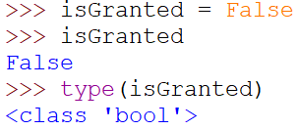
Creating a Boolean Variable - bool
Boolean Variables contain only one of two values: True or False
To create a Boolean variable, simply set a variable to True or False
Do not put quotes around these keywords
Its data type is: bool
Boolean variables are typically created within an IF statement
isGranted = False
if age >= 65:
isSenior = True
else:
isSenior = False
if temp >= 100.0:
hasFever = True
else:
hasFever = False
if name != '' :
hasName = True
else:
hasName = False

Slide 29
Testing a Boolean Variable
Assigning a Boolean
In memory
if age >= 65:
isSenior = True
else:
isSenior = False
isSenior
True
Testing the TRUE Case
PREFERRED
if isSenior == True:
print('Apply discount')
if isSenior:
print('Apply discount')
OK
Testing the FALSE Case
PREFERRED
if isSenior == False:
print('Do not apply discount')
if not isSenior:
print('Do not apply discount')
OK

Slide 30
Testing a Boolean Variable
Assigning a Boolean
Testing a Boolean
if temp >= 100.0:
hasFever = True
else:
hasFever = False
if hasFever:
print('Administer medication')
if hasFever:
print('Administer medication')
else:
print('Check other vitals')
Assigning a Boolean
Testing a Boolean
if name != '' :
hasName = True
else:
hasName = False
if not hasName:
print('Please complete the form')

Slide 31
Logical Operators – And, Or, Not

Slide 32
Logical Operators – AND
AND Operator
Condition
=
Boolean expression
- all Boolean expressions must be True!
if major == 'MIS' and classification == 'Senior':
print('MIS Seniors - attend the job fair!')
if temp > 100 and main_symptom == 'coughing':
print('Diagnosis: Flu')
if major == 'MIS' and classification == 'Senior' and gpa >= 3.25:
print('Register for an interview')

Slide 33
Logical Operators – OR
OR Operator
Condition
=
Boolean expression
- at least one Boolean expression must be True!
if temp > 100 or heart_rate > 100:
print('ER Admit Level: 1')
if classification == 'Junior' or classification == 'Senior':
print('Juniors and Seniors - Attend job fair!')
if major == 'MIS' and (classification == 'Senior' and gpa >= 3.25):
print('Register for an interview')

Slide 34
String Modification functions
These functions will change the case of a string: upper(), lower(), title()
gender = input('Enter gender: ')
if gender == 'M'
print('Male')
Issue?
a string
method
any_str.upper()
if gender == 'M' or grade == 'm':
print('Male')
OK
lower() converts a string to lower case
upper() converts a string to upper case
title() converts a string to title/proper case
if gender.upper() == 'M':
print('Male')
BETTER
gender = input('Enter gender: ').upper()
BEST, handle it early!
* But, be aware of concern with changing user input

Slide 35
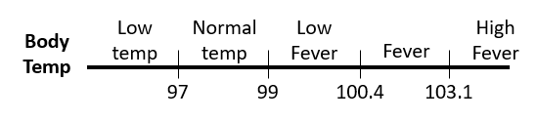
OR, AND
Two extremes – use OR
Between two values – use AND
Sales
Sales
5k
10k
15k
20k
5k
10k
15k
20k
if sales < 5000 or sales >= 20000:
print('Notify manager!')
if sales >= 5000 and sales < 20000:
print('Normal sales valid')
However, do not use AND, OR with a “Range of Values” – see the code for this on an earlier slide

Slide 36
Short Circuit Evaluation
AND Operator
if major == 'MIS' and classification == 'Senior':
print('Attend job fair!')
- if 1st expression is false,
it exits the IF structure.
OR Operator
if classification == 'Junior' or classification == 'Senior':
print('Attend job fair!')
- if 1st expression is true, it enters the IF block.

Slide 37
Logical Operators – NOT
NOT Operator
 | Any Condition | Yields
not | True | → | False
not | False | → | True
- reverses the Boolean
classification = input('Enter class (FR, SO, JR, SR): ').upper()
if classification == 'SO' or classification == 'JR' or classification == 'SR':
print('Approved to register now!')
if not (classification == 'FR'):
print('Approved to register now!')
Sometimes, it is simpler to code it with a NOT.
if not (classification == 'FR' or classification == 'S'):
print('Approved to register now!')
This one only allow Juniors & Seniors to register now.
Notice it is an OR not an AND!

Slide 38
String Comparison

Slide 39

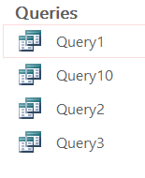
String Comparison –with Numbers
String Comparison is used anytime data is sorted.
Notice the issue when sorting strings that contain numbers!
In MS Excel…
In MS Access…
Solution!
Solution!
Before
Sorted
Enter chapter
names this way…
Enter query names this way…
Chapter 3
Chapter 9
Chapter 5
Chapter 4
Chapter 1
Chapter 10
Chapter 7
Chapter 6
Chapter 11
Chapter 8
Chapter 2
Chapter 1
Chapter 10
Chapter 11
Chapter 2
Chapter 3
Chapter 4
Chapter 5
Chapter 6
Chapter 7
Chapter 8
Chapter 9
Chapter 01
Chapter 02
Chapter 03
Chapter 04
Chapter 05
Chapter 06
Chapter 07
Chapter 08
Chapter 09
Chapter 10
Chapter 11
Query01
Query02
Query03
Query04
Query05
Query06
Query07
Query08
Query09
Query10
Query11

Slide 40
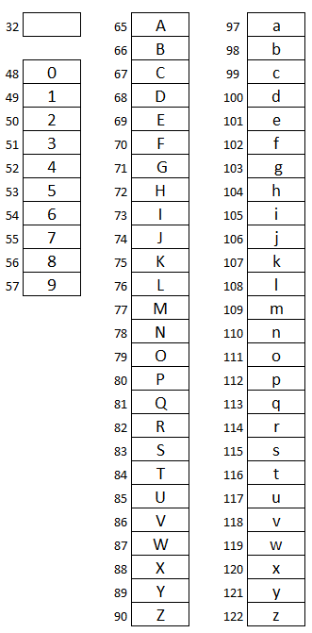
String Comparison – Rules
ASCII - numeric codes for characters
String comparison starts on the left …
and continues until it finds a character that is different
ASCII Values - lowest to highest
Space
Numbers - ‘0’ evaluates less than ‘9’
Uppercase letters - ‘A’ evaluates less than ‘Z’
Lowercase letters - ‘a’ evaluates less than ‘z’

Slide 41
String Comparison – Examples
ASCII - numeric codes for characters
name1:
name2:
John
John
john
JOHN
John Doe
JohnDoe
Equality
if name1 == name2:
print('The names are the same')
True
False
False
Inequality
if name1 != name2:
print('The names are different')
False
True
True
Less than
if name1 > name2:
print('The name1 is greater than name2')
False
True
False
Greater than
if name1 < name2:
print('The name1 is less than name2')
False
False
True

